Slide 1
Lecture No.4 Types of Relations
REFLEXIVE RELATION:
Let R be a relation on a set A. R is reflexive if and only if, for all a ∈ A,
(a, a) ∈R or equivalently aRa. That is, each element of A is related to itself.
REMARK
R is not reflexive iff there is an element “a” in A such that
(a, a) ∉R. That is, some element “a” of A is not related to itself.
EXAMPLE: Let A = {1, 2, 3, 4} and define relations R1, R2, R3, R4 on A as follows:
R1 = {(1, 1), (3, 3), (2, 2), (4, 4)}
R2 = {(1, 1), (1, 4), (2, 2), (3, 3), (4, 3)}
R3 = {(1, 1), (1, 2), (2, 1), (2, 2), (3, 3), (4, 4)}
R4 = {(1, 3), (2, 2), (2, 4), (3, 1), (4, 4)}
Then,
R1 is reflexive, since (a, a) ∈R1 for all a ∈A.
R2 is not reflexive, because (4, 4) ∉R2.
R3 is reflexive, since (a, a) ∈R3 for all a ∈A.
R4 is not reflexive, because (1, 1) ∉R4, (3, 3) ∉R4

Slide 2
DIRECTED GRAPH OF A REFLEXIVE RELATION:
The directed graph of every reflexive relation includes an arrow from every point
to the point itself (i.e., a loop).
EXAMPLE :
Let A = {1, 2, 3, 4} and define relations R1, R2, R3, and R4 on A by
R1 = {(1, 1), (3, 3), (2, 2), (4, 4)}
R2 = {(1, 1), (1, 4), (2, 2), (3, 3), (4, 3)}
R3 = {(1, 1), (1, 2), (2, 1), (2, 2), (3, 3), (4, 4)}
R4 = {(1, 3), (2, 2), (2, 4), (3, 1), (4, 4)}
Then their directed graphs are the following:

Slide 3
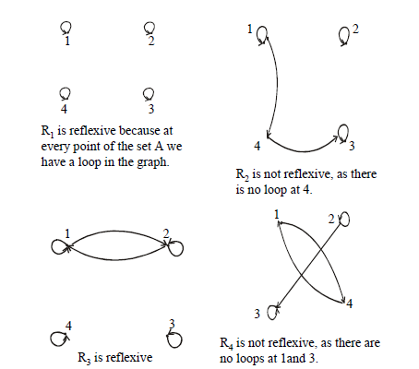

Slide 4
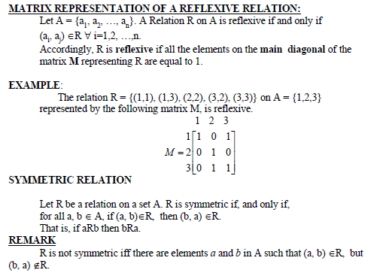

Slide 5
EXAMPLE
Let A = {1, 2, 3, 4} and define relations R1, R2, R3, and R4on A as
follows.
R1 = {(1, 1), (1, 3), (2, 4), (3, 1), (4,2)}
R2 = {(1, 1), (2, 2), (3, 3), (4, 4)}
R3 = {(2, 2), (2, 3), (3, 4)}
R4 = {(1, 1), (2, 2), (3, 3), (4, 3), (4, 4)}
Then R1 is symmetric because for every order pair (a, b) in R1also have (b, a) in
R1. For example, we have (1, 3) in R1 then we have (3, 1) in R1. Similarly all other
ordered pairs can be checked.
R2 is also symmetric. We say it is vacuously true.
R3 is not symmetric, because (2,3) ∈ R3 but (3,2) ∉ R3.
R4 is not symmetric because (4,3) ∈ R4 but (3,4) ∉ R4.

Slide 6
DIRECTED GRAPH OF A SYMMETRIC RELATION
For a symmetric directed graph whenever there is an arrow going from one point
of the graph to a second, there is an arrow going from the second point back to
the first.
EXAMPLE
Let A = {1, 2, 3, 4} and define relations R1, R2, R3 and R4 on A by the directed
graphs:
R1 = {(1, 1), (1, 3), (2, 4), (3, 1), (4,2)}
R2 = {(1, 1), (2, 2), (3, 3), (4, 4)}
R3 = {(2, 2), (2, 3), (3, 4)}
R4 = {(1, 1), (2, 2), (3, 3), (4, 3), (4, 4)}

Slide 7
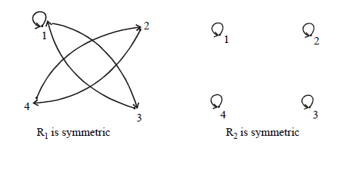

Slide 8
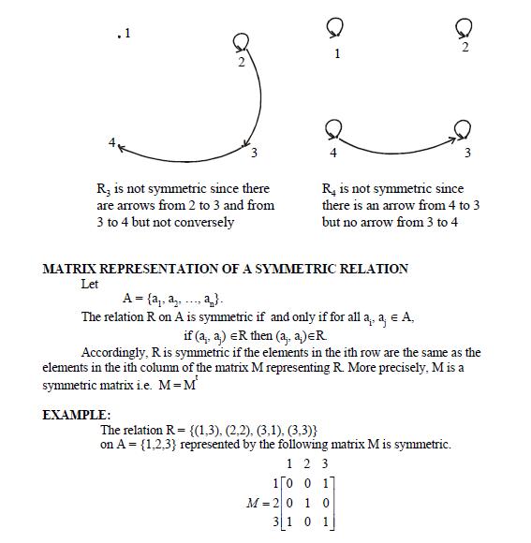

Slide 9
TRANSITIVE RELATION
Let R be a relation on a set A. R is transitive if and only if for all a, b, c ∈A,
if (a, b) ∈R and (b, c) ∈R then (a, c) ∈R.
That is, if aRb and bRc then aRc.
In words, if any one element is related to a second
and that second element is related to a third, then the first is related to the third.
Note: The “first”, “second” and “third” elements need not to be distinct.
REMARK
R is not transitive iff there are elements a, b, c in A such that

Slide 10
if (a, b) ∈R and (b, c) ∈R but (a, c) ∉R.
EXAMPLE
Let A = {1, 2, 3, 4} and define relations R1, R2 and R3 on A as follows:
R1 = {(1, 1), (1, 2), (1, 3), (2, 3)}
R2 = {(1, 2), (1, 4), (2, 3), (3, 4)}
R3 = {(2, 1), (2, 4), (2, 3), (3,4)}
Then R1 is transitive because (1, 1), (1, 2) are in R, then to be transitive relation
(1,2) must be there and it belongs to R.
Similarly for other order pairs. R2 is not transitive since (1,2) and (2,3) ∈ R2 but
(1,3) ∉ R2.
R3 is transitive.
DIRECTED GRAPH OF A TRANSITIVE RELATION
For a transitive directed graph, whenever there is an arrow going from one point
to the second, and from the second to the third, there is an arrow going directly from the
first to the third.

Slide 11
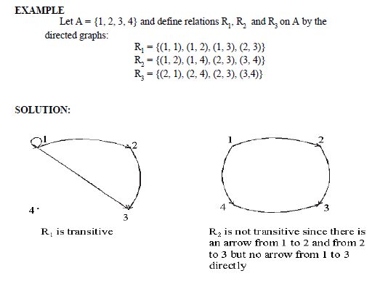
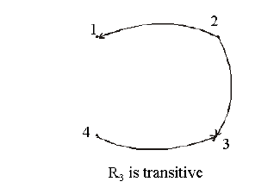

Slide 12
EXERCISE:
Let A = {1, 2, 3, 4} and define the null relation φ and universal relation
A ⋅A on A. Test these relations for reflexive, symmetric and transitive properties.
SOLUTION:
Reflexive:
∅ is not reflexive since (1,1), (2,2), (3,3), (4,4) ∉ ∅. b) A ⋅ A is reflexive since (a,a) ∈ A ⋅ A for all a ∈ A.
Symmetric
a) For the null relation ∅ on A to be symmetric, it must satisfy the implication: if (a,b) ∈ ∅ then (a, b) ∈ ∅.
Since (a, b) ∈ ∅ is never true, the implication is vacuously true or true by default. Hence ∅ is symmetric.
b) The universal relation A ⋅ A is symmetric, for it contains all ordered pairs of elements of A. Thus,
if (a, b) ∈ A ⋅ A then (b, a) ∈ A ⋅ A for all a, b in A.
Transitive
a) The null relation ∅ on A is transitive, because the implication. if (a, b) ∈ ∅ and (b, c) ∈ ∅ then (a, c) ∈ ∅ is true by default, since the condition (a, b) ∈ ∅ is always false.
b) The universal relation A ⋅ A is transitive for it contains all ordered pairs of
elements of A. Accordingly, if (a, b) ∈ A ⋅ A and (b, c) ∈ A ⋅ A then (a, c) ∈ A ⋅ A

Slide 13
EXERCISE:
Let A = {0, 1, 2} and
R = {(0,2), (1,1), (2,0)} be a relation on A.
1. Is R reflexive? Symmetric? Transitive?
2. Which ordered pairs are needed in R to make it a reflexive and transitive relation.
SOLUTION:
1. R is not reflexive, since 0 ∈ A but (0, 0) ∉R and also 2 ∈ A but (2, 2) ∉R.
R is clearly symmetric.
R is not transitive, since (0, 2) & (2, 0) ∈ R but (0, 0) ∉R.
2. For R to be reflexive, it must contain ordered pairs (0,0) and (2,2).
For R to be transitive,
we note (0,2) and (2,0) ∈ but (0,0) ∉R.
Also (2,0) and (0,2) ∈R but (2,2)∉R.
Hence (0,0) and (2,2). Are needed in R to make it a transitive relation.

Slide 14
EXERCISE:
Define a relation L on the set of real numbers R be defined as follows:
for all x, y ∈R, x L y ⇔ x < y.
a. Is L reflexive?
b. Is L symmetric?
c. Is L transitive?
SOLUTION:
a. L is not reflexive, because x < x for any real number x.
(e.g. 1 < 1)
b. L is not symmetric, because for all x, y ∈R, if
x < y then y < x
(e.g. 0 < 1 but 1 < 0)
c. L is transitive, because for all, x, y, z ∈R, if x < y
and y < z, then x < z.
(by transitive law of order of real numbers).

Slide 15
EXERCISE:
Define a relation R on the set of positive integers Z+ as follows: for all a, b ∈Z+, a R b iff a ⋅ b is odd.
Determine whether the relation is
a. reflexive b. symmetric c. transitive
SOLUTION:
Firstly, recall that the product of two positive integers is odd if and only if both of them are odd.
a. Reflexive
R is not reflexive, because 2 ∈ Z+ but 2 R 2 for 2 ⋅ 2 = 4 which is not odd.
b. Symmetric
R is symmetric, because if a R b then a ⋅ b is odd or equivalently b ⋅ a is odd
( b ⋅ a = a ⋅ b) ⇒ b R a.
c. Transitive
R is transitive, because if a R b then a ⋅ b is odd
⇒ both “a” and “b” are odd. Also bRc means b ⋅ c is odd, ⇒ both “b” and “c” are odd.
Now if aRb and bRc, then all of a, b, c are odd and so a ⋅ c is odd. Consequently
aRc.

